Slide 1


Infrastructure As Code
with

Slide 2


About me
I am Senior DevOps Engineer at Mctekk, passionate about everything related to Open Source, practitioner in the art of sharing and smiling at life in all its moments and forms.
@WilkinsOrtiz4 github.com/Wilkins089

Slide 3
What is IaC?

Slide 4
What is IaC?
“...the practice of treating infrastructure as if it were code.” Carl Caum - Puppet
“...the process of managing and provisioning computer data centers through machine-readable definition files...” A lot of people - Wikipedia

Slide 5
So… Why?

Slide 6


FIRULAIS
AWS Console

Slide 7

FIRULAIS
AWS Console
EC2

Slide 8

RDS
FIRULAIS
AWS Console
EC2

Slide 9

RDS
FIRULAIS
AWS Console
EC2
S3

Slide 10

RDS
FIRULAIS
AWS Console
EC2
S3
AWS Cloudfront

Slide 11

RDS
AWS ELB
FIRULAIS
AWS Console
EC2
S3
AWS Cloudfront

Slide 12
RDS
EC2
EC2
EC2
FIRULAIS
AWS Console
EC2
S3
AWS Cloudfront

Slide 13


Slide 14
But… Is this for me? Does it deserve my time?

Slide 15
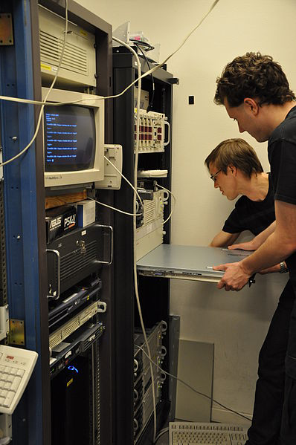
Is your provisioning fast enough?

Slide 16
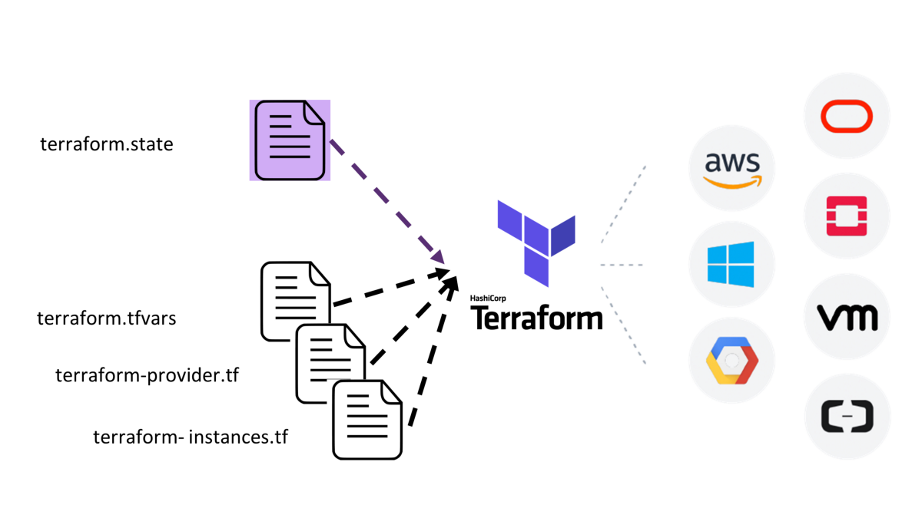

Slide 17
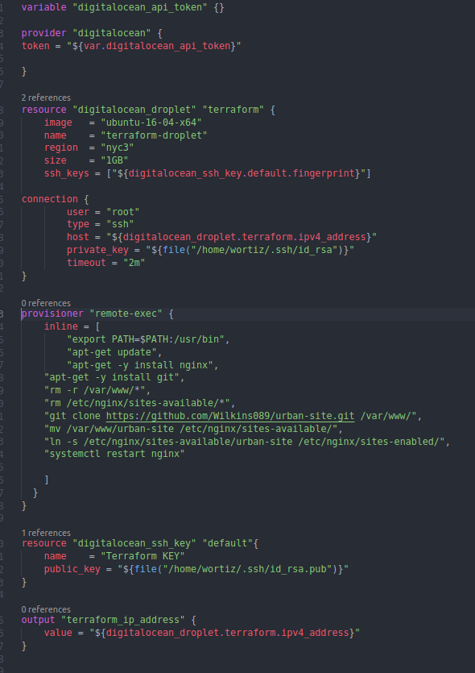
do_terraform.tf:

Slide 18

Talk is cheap.
Show me the code.
(Linus Torvalds)

